Slide 1

IEA SHC
Solar Award 2024

Slide 2

IEA SHC Solar Award
The IEA SHC Solar Award recognizes outstanding contributions and leadership or achievements in the field of solar heating and cooling.
This year’s award recognizes a project that reduces costs and emissions by incorporating solar thermal technologies in an industrial process.

Slide 3
Shortlisted Nominations
Five projects were shortlisted.
The recipient of the 2024 Solar Award will be one of our five finalist projects from…
France
Kenya
Spain
Uganda
United States

Slide 4
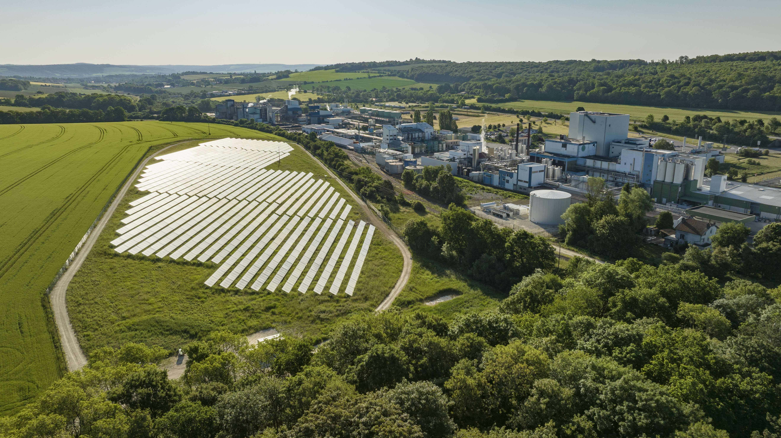
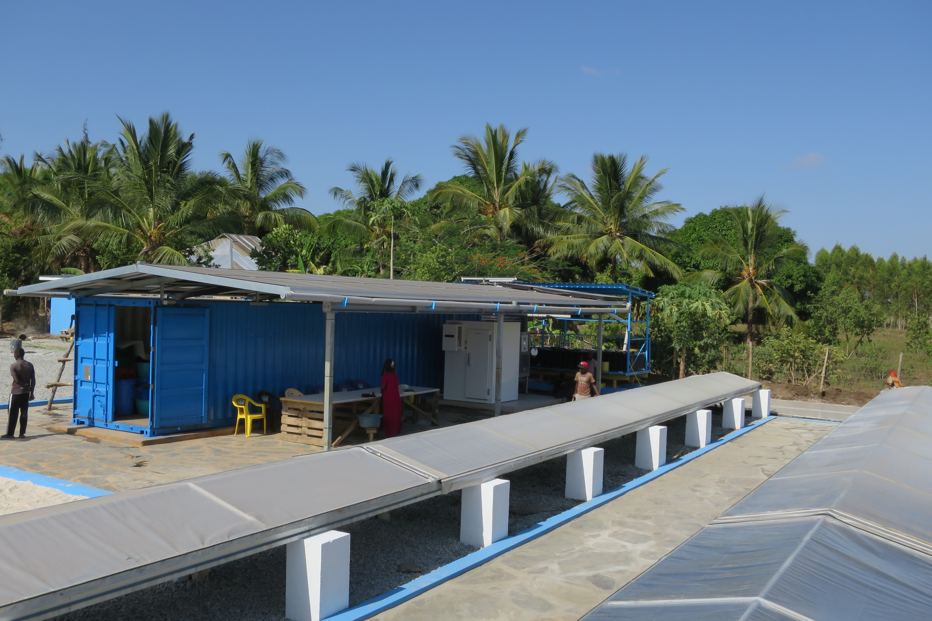
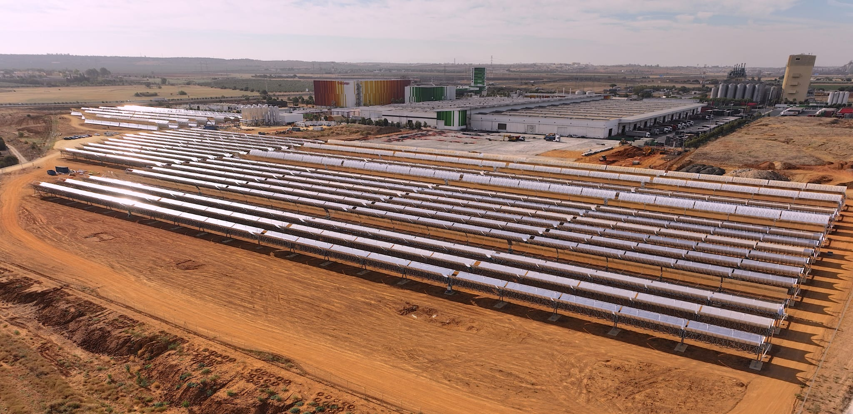
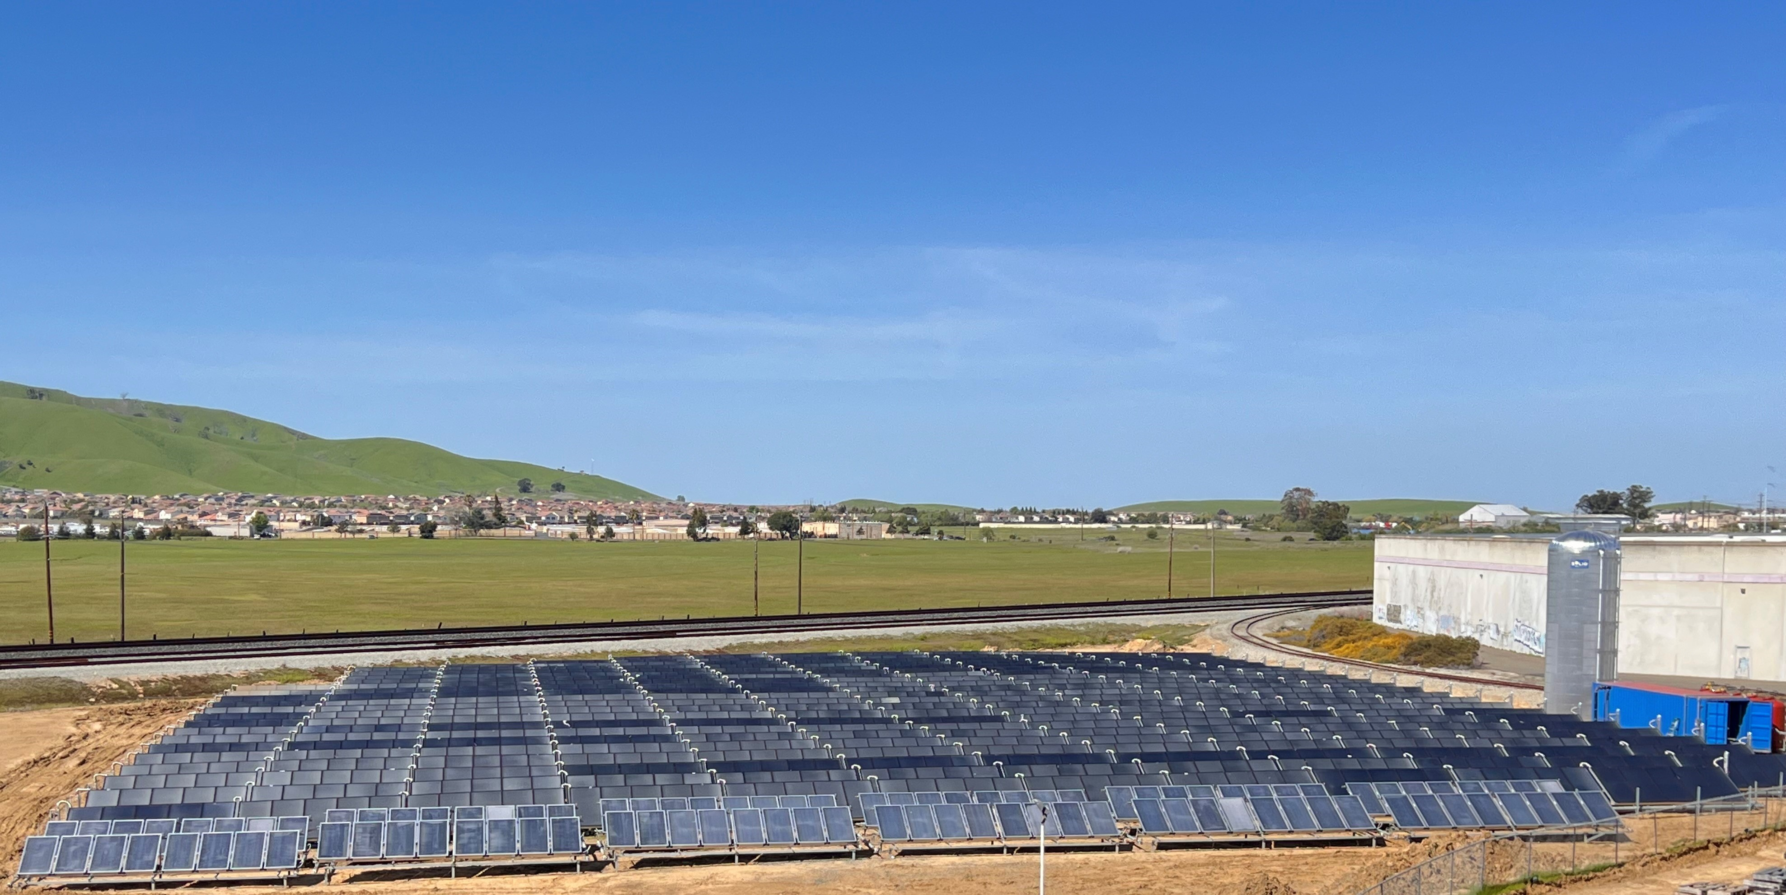
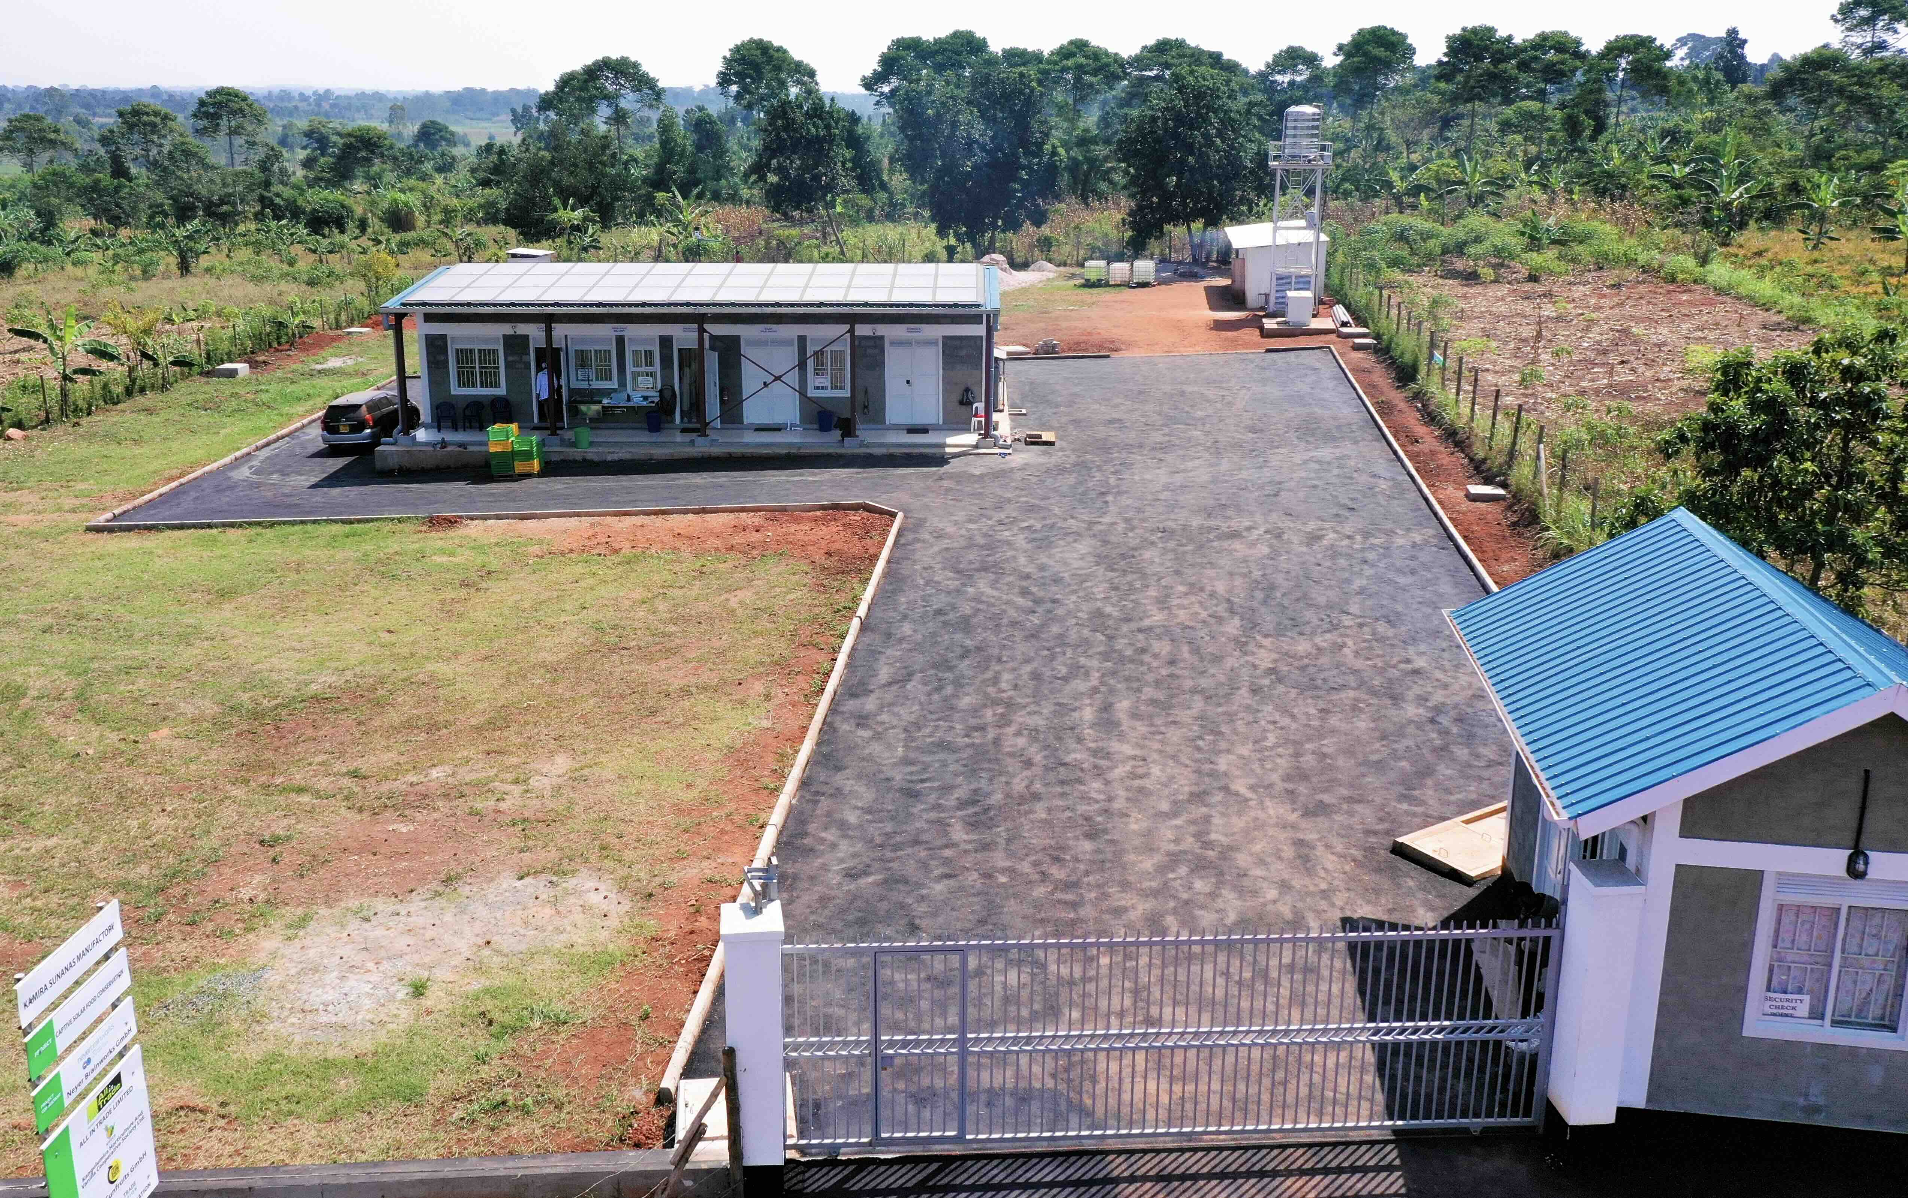
Photo credit: AZTEQ/Solarlite - Engie
Photo credit: IMAGESinAIR
Photo credit: Fraunhofer ISE
ENGIE Spain – HEINEKEN brewery
Seville, Spain
Newheat – LACTOSOL dairy plant Verdun, France
SolCoolDry project– food processing Mwazaro, Kenya
SHC AWARD SHORTLIST
Photo credit: SOLID
SOLID – BALL aluminum packaging California, USA
Photo credit: Russel Pictures, Uganda
Neyer Brainworks l TWIGA Sun Fruits - food processing Kangulumira, Uganda
Notes:
Newheat LACTOSOL project demonstrates an industrial process that competitively reduces gas consumption using solar heat technology at the process level. Uses solar heat to convert liquid whey, a by-product of cheesemaking, into whey powder. Solar thermal plant generates about 8,500 MWh, reducing the site’s gas consumption by 6% (11% for the drying tower and 30% for preheating needs) and CO2 emissions by 2,000 tons per year.
Fraunhofer ISE SolCoolDry project demonstrates the advantages of a replicable 100% solar-powered, off-grid food processing system. Combines the advantages of solar thermal and PV for two processes: ice production and food drying. Local fishermen and other farmers now have a 24-hour running solar drying system to dry produce and can locally produce ice for cooling fish and other produce.
ENGIE Heineken Seville installation holds the title of largest solar thermal plant for industrial use in Europe and marks the first use of Concentrated Solar Power (CSP) technology in a factory. Installed thermal power of 30.38 MW and thermal storage of 68 MWh. Reduces gas consumption by 60% and CO2 emissions reduction of 8,924 tons annually.
SOLID project uses solar heat to produce up to 8 million aluminum cans daily at its Fairfield, California plant. A 3,956 m² solar heat plant with a thermal capacity of 2.8 MW. This is California's largest solar thermal facility and the second largest in the US. It is projected to save over 5,860 MWh (200,000 therms) of natural gas annually.
Neyer Brainworks & TWIGA Sun Fruits demonstrates an integrated farm2fork system solution for a self-sufficient solar pineapple drying facility. The holistic agriculture approach takes pineapples from the field to a 100% solar-processed product for international markets. 5-year payback is achieved by combining solar heat (covering 80% of energy needs with photovoltaic (covering the remaining 20%). Uniquely focused on sustainability 1) Economic impact: local production and shortened value chain from producers to consumers, 2) Social impact: high-quality jobs for women in rural regions, and 3) Ecological impact: 100% solar-powered operations

Slide 5
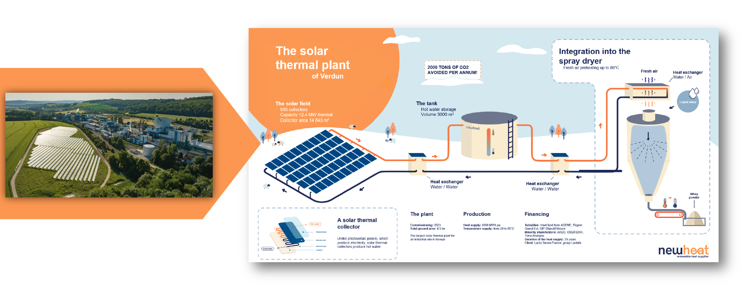
SHC Award Winner
Newheat
LACTOSOL dairy plant
Verdun, France
Notes:
Receiving the award on behalf of Newheat:
François-Xavier Sarda, Industry Key Account Manager, Thomas Colin De Verdière, Control Engineer, and Alexis Gonnelle, Principal Scientist
Invite Newheat to the stage. While walking to stage ask for video to start.

